Slide 1

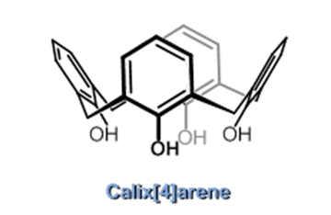
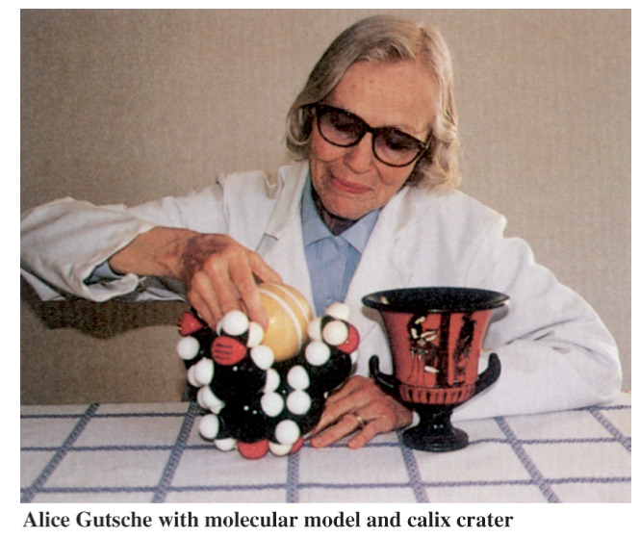
Calixarene :Macrocycles with (Almost) Unlimited Possibilities
NIKHΦΟΡΟΥ ΑΓΑΠΗ Α.Μ. 825
ΧΗΜΕΙΑ ΜΑΚΡΟΚΥΚΛΙΚΩΝ ΕΝΩΣΕΩΝ
Υπ. Καθ. : Koυτσολέλος Αθανάσιος

Slide 2
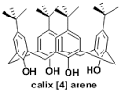
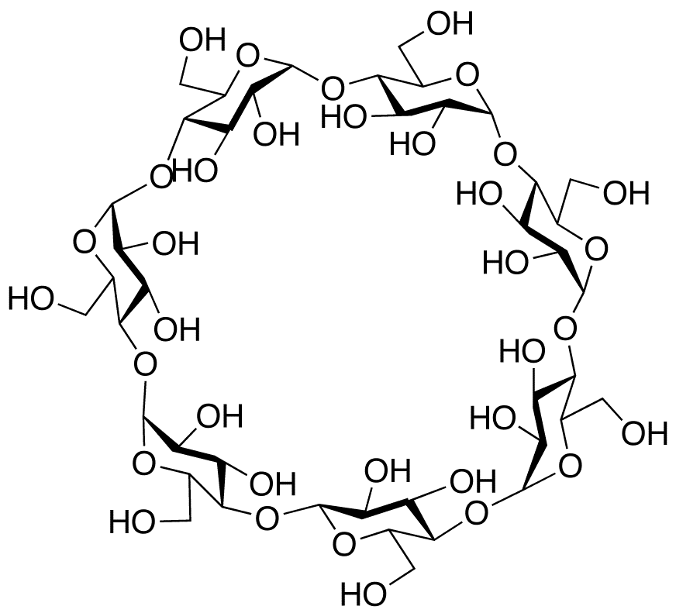
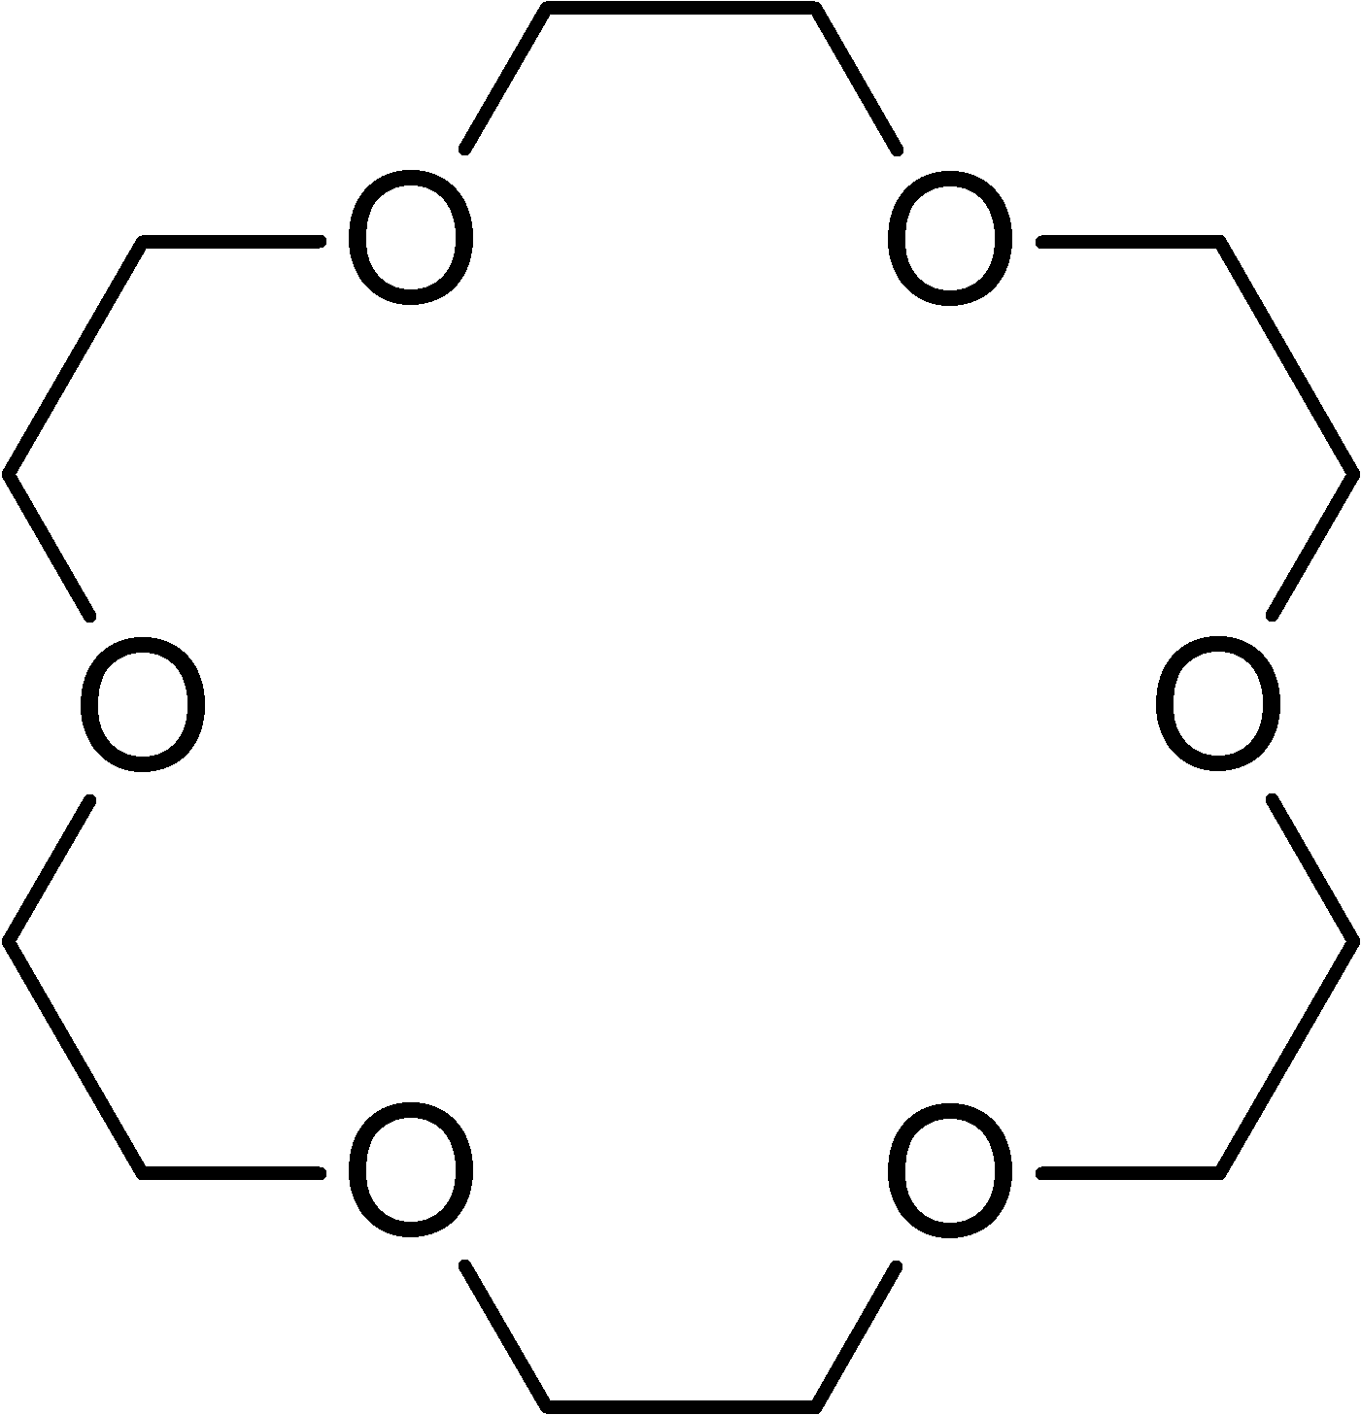
Introduction to Calixarene Chemistry
Molecular Chemistry to Supramolecular Chemistry
Supramolecular Chemistry :
Self-assembly of subunits
Selective host-guest interactions
Self-assembly
Particles → Molecules → New Molecules → Supramolecular arrays or assemblies
Host-Guest Chemistry
Cyclodextrins
Crown-ethers
Calixarenes

Slide 3

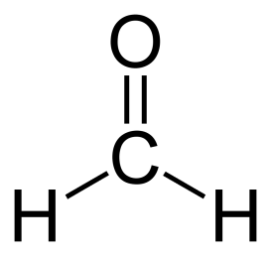
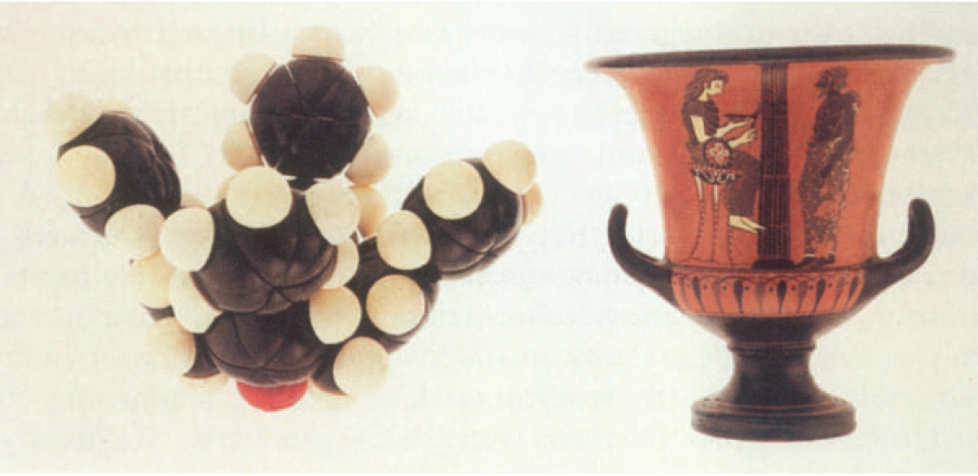
Introduction to Calixarene Chemistry
19 αιώνας (Adolph von Baeyer) :
Παρουσία Ισχυρού Οξέος
30 χρόνια αργότερα (Leo Baekland) : Κρυσταλλικό Στερεό γνωστό ως Bakelite “The first synthetic plastic in the world”
Alois Zinke :
Παρουσία Βάσης
p-alkyl substituted phenol + formaldehyde
30 χρόνια μετά (C.D. Gutsche):
‘’Calixarene’’
Calix Crater (basket): Λόγω δομής
Αrene : Λόγω αρωματικής φύσης
→
Μαύρη ρητίνη (πίσσα)
+
→
Στερεό υψηλού σημείου ζέσης

Slide 4
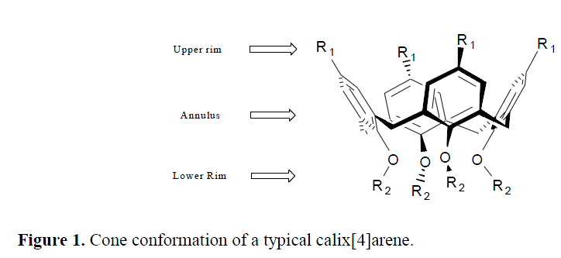
Introduction to Calixarene Chemistry
Κυκλοολιγομερές προϊόν συμπύκνωσης φαινολών-φορμαλδεΰδης (όξινη/βασική)
Kύπελλο έχοντας άνω, κάτω χείλος και στεφάνη στο κέντρο
Υδρόφοβες κοιλό-
τες → cavitands
Host Guest chemistry
n- : αριθμός φαινο-
λικών μονάδων
Τροποποιήσεις στα
χείλη→ επιλεκτικότητα
Ποικίλες χρήσεις : Potential ligand for metal ions sensing, toxic metal ions extractants, receptors for neutral and charged species, catalysts, electrochemical sensors , chiral recognition devices, stationary phases , modifiers

Slide 5

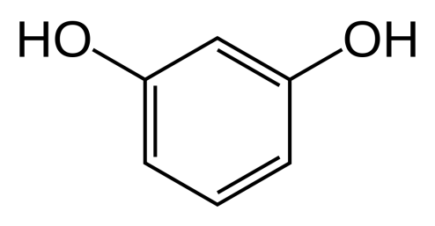
Synthesis
Aromatic components
Aldehyde most often used
Phenol
acetaldehyde or larger
Resorcinol
Pyrogallol
1.Ηλεκτρονιόφιλη Αρωματική Υποκατάσταση
2. Απομάκρυνση Νερού
3. Δεύτερη υποκατάσταση
Καταλύτης οξύ ή βάση

Slide 6
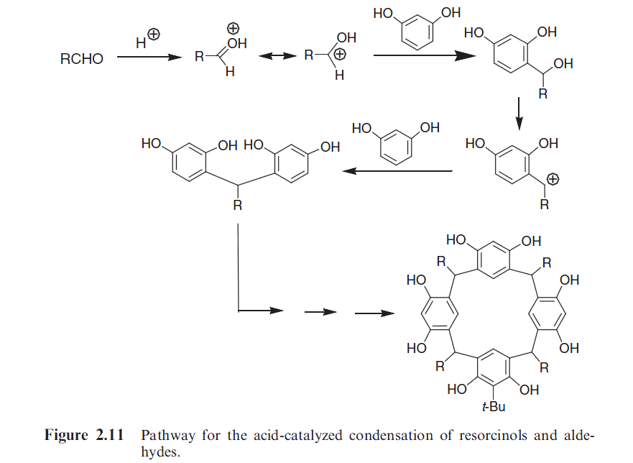
Synthesis
Mechanism of the Acid-catalyzed Reaction

Slide 7
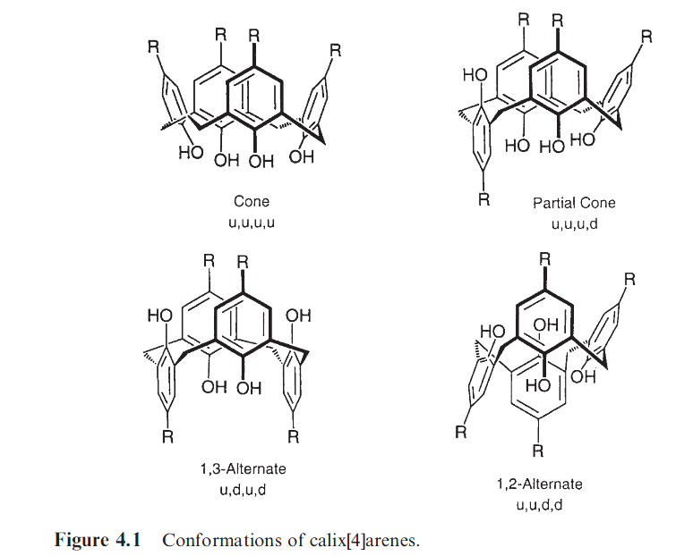
Structure
↑aryl groups => ↑ διαμορφώσεις calix[4]arenes : 4 calix[5]arenes :4 calix[6]arenes:8
calix[8]arenes:16
Για παράγωγα των calixarenes -> reference
aryl group
Υιοθέτηση των δομών λόγω flexibility περιστροφής του δεσμού Ar-CH2-Ar

Slide 8
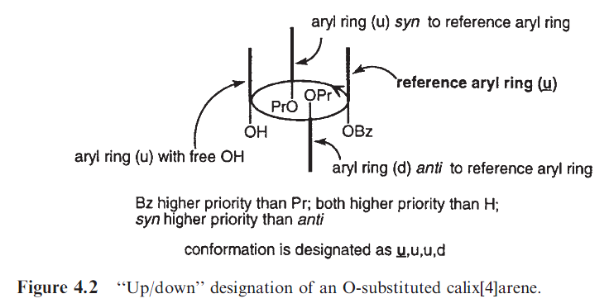
Structure
p-tert-Bu-ArOMe ring takes precedence over a p-tert-Bu-ArOH
p-tert-Bu-ArOH ring takes precedence over a p-MeArOH ring
an ArSO2 ring takes precedence over an ArCO ring
If two or more aryl rings are identical the one that is flanked by the greater number of higher priority aryl rings is chosen.
The reference group is indicated by a bold-faced and/or underlined u or d and in most instances can be arbitrarily assigned an ‘‘up’’ orientation.

Slide 9
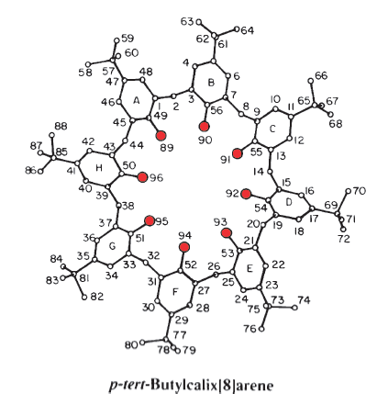
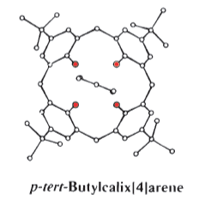
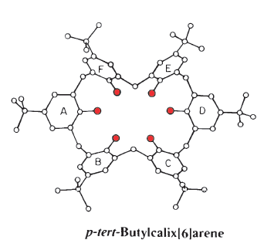
Physical Properties of Calixarenes
Σημεία Ζέσεως
Ασυνήθιστα υψηλές τιμές
342–344 0C
372–374 0C
Εύρος και μέγεθος σ.ζ. ένδειξη καθαρότητας
calixarenes
Εστέρες/ αιθέρες καλιξαρενίων χαμηλότερο σ.ζ. από τα μη τροποποιημένα calixarenes
411–412 1C to 418–420 0C

Slide 10
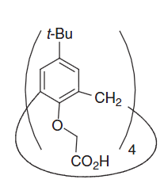
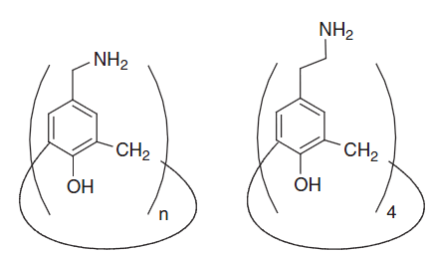
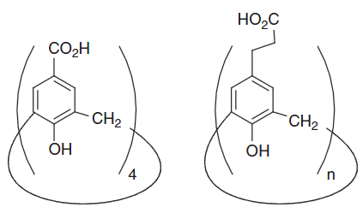

Physical Properties of Calixarenes
Διαλυτότητες
Αδιάλυτες σε νερό κ υδατικές βάσεις
Μικρή διαλυτότητα σε οργανικούς διαλύτες
Ικανοποιητική διαλυτότητα σε χλωροφόρμιο, πυριδίνη, δισουλφίδιο άνθρακα
Αιθέρες κ Εστέρες παράγωγα μεγαλύτερη διαλυτότητα σε οργανικούς διαλύτες

Slide 11
Spectral Properties of Calixarenes
Φάσμα Υπερύθρου
Ασυνήθιστη χαμηλή συχνότητα δόνησης –ΟΗ
3179 cm-1 for the cyclic tetramer
3190 cm-1 for the cyclic octamer
3300 cm-1 for the cyclic pentamer
Τα υπόλοιπα calixarenes ανάμεσα στις παραπάνω τιμές
ΙΣΧΥΡΟΙ ΕΝΔΟΜΟΡΙΑΚΟΙ ΔΕΣΜΟΙ Η !!!!!!!!!!
Δακτυλικό Αποτύπωμα IR αρκετά όμοιο στην περιοχή 900-1500 cm-1
ΑΛΛΑ στα 500-900 cm-1 χαρακτηριστικές δονήσεις – αποτύπωμα
693 cm-1 and 571 cm-1 for the cyclic pentamer
762 cm-1 for the cyclic hexamer
796 cm-1 for the cyclic heptamer
and a less-well-resolved set of lines at 600–500 cm1 for the cyclic octamer.

Slide 12
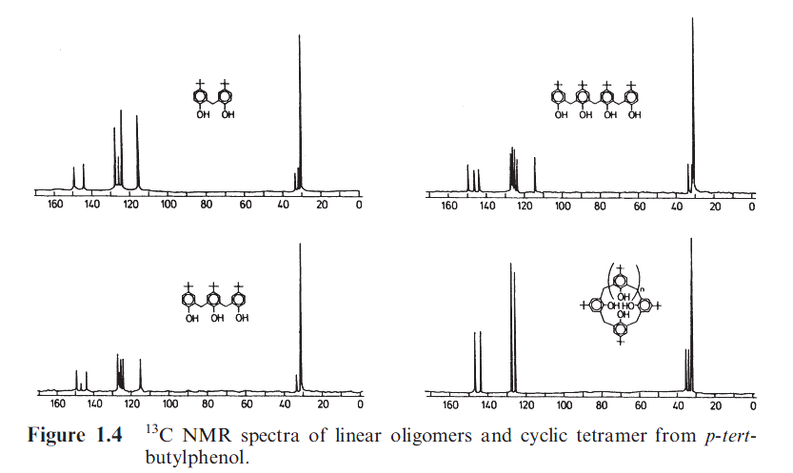
Spectral Properties of Calixarenes
Φάσμα Υπεριώδους
2 μέγιστα απορρόφησης στα 280nm κ 288nm (διαλύτες CHCl3 κ διοξάνη)
Φάσμα NMR
Χρησιμότητα τεχνικής
Συμμετρία => απλούστερο φάσμα
4 κορυφές για αρωματικούς C
1 για –CH2
2 για tert-butylC

Slide 13
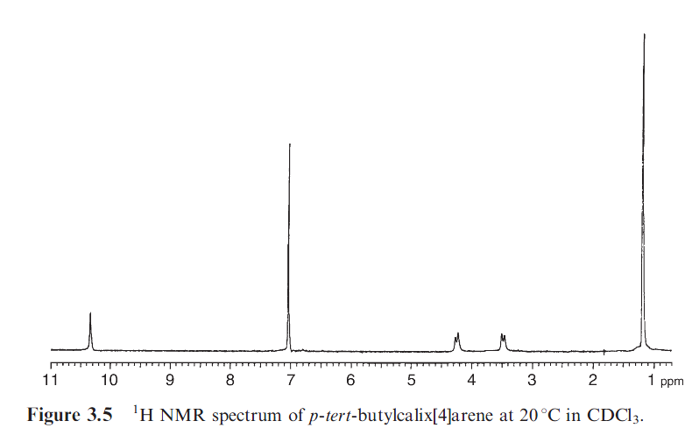
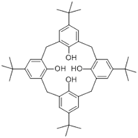
Spectral Properties of Calixarenes
Απλό φάσμα για συμμετρικά υποκατεστημένα calixarenes
‘Ολα singlet
-CH2 ζευγάρι από doublet
Sharp singlet (60 oC) - flexibility

Slide 14
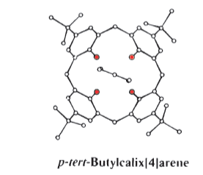
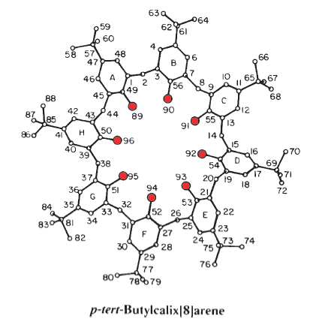
X-Ray Crystallography: Η τελική απόδειξη της δομής
1979 (Andreetti,Ungaro and Pochinine) : 1^{Η} κρυσταλλογραφική δομή phenol-derived calixarene
Eπιβεβαιώνεται 4 χρόνια αργότερα
Κυκλική τετραμερής δομή
Διαπιστώθηκε τολουόλιο μέσα στην κοιλότητα
ΔΥΝΑΤΟΤΗΤΑ ΣΧΗΜΑΤΙΣΜΟΥ ΣΥΜΠΛΟΚΩΝ
ΕΓΚΛΕΙΣΜΟΥ
Βελόνες χάνουν την μορφολογία κ καταρρέουν σε σκόνη
Κρυστάλλωση από πυριδίνη
Διατήρηση συμπλόκου σε περιβάλλον κορεσμένο πυριδίνης κατά τη συλλογή των ανακλάσεων Χ-ray

Slide 15
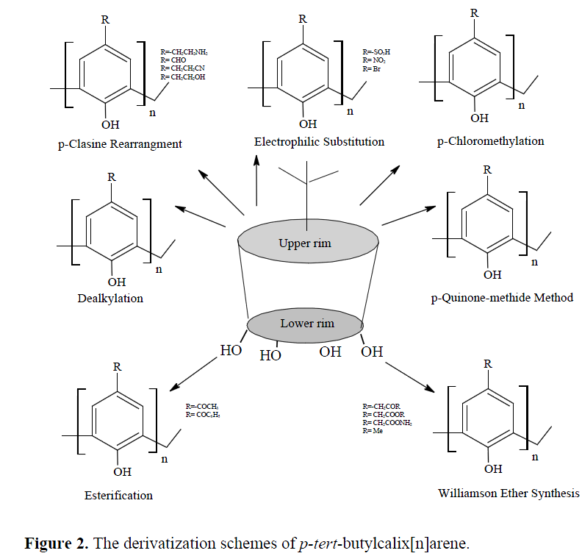
Functionalization
Upper rim (wide) : made up of tert-butyl groups on the phenolic ring
Lower (narrow) rim :comprised of phenolic hydroxyl groups

Slide 16
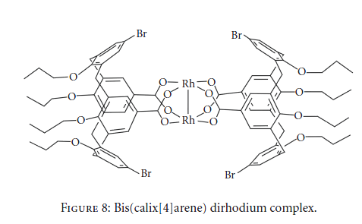
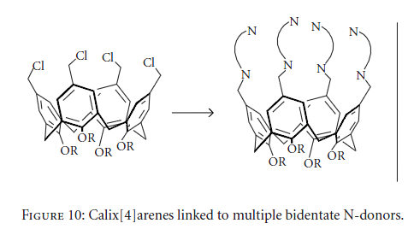
Functionalization
Α.Upper-rim modification of calix[n]arenes
Easy removal of the t-butyl group
An Rh−Rh unit formed an intermolecular link between two calix[4]arenes macrocycles
ligand for transition metal catalysts
Heterocyclylmethanamines attached at the upper rim of calix[4]arene
ligand for synthetic modeling of multinuclear metalloenzymes

Slide 17
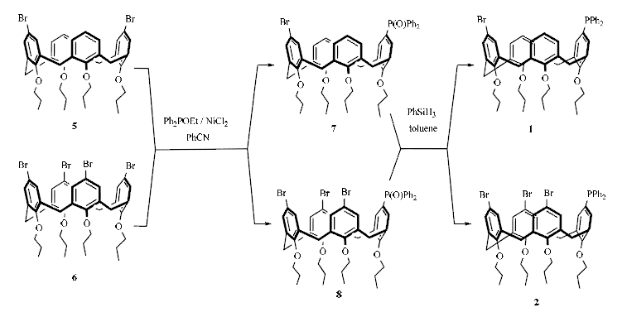
Functionalization
Calixarene monophosphines 1 and 2
Nickel-catalyzed reactions of 5 and of 6 with Ph²POEt affording calixarene phosphine oxides 7 and 8
Reduction with PhSiH³ to give 1 and 2

Slide 18
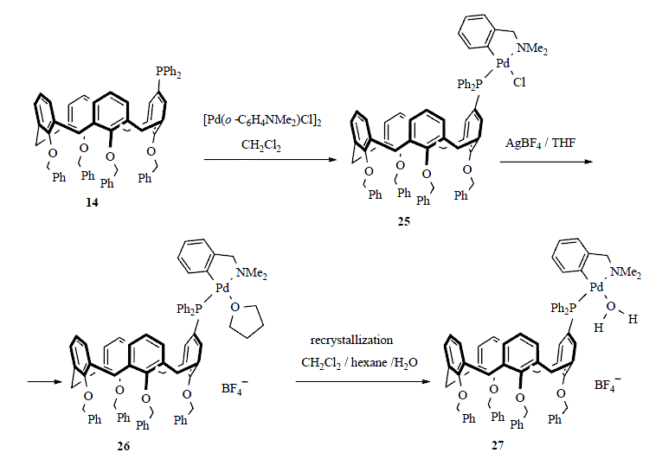
Functionalization
14 with [Pd(o-C⁶H⁴NMe²)Cl]² affords complex 25
Treated with AgBF⁴ in THF to give the complex 26
Recrystallization of 26 performed by slow diffusion of hexane into a commercial undried dichloromethane solution of 26 yields the aquo complex 27

Slide 19
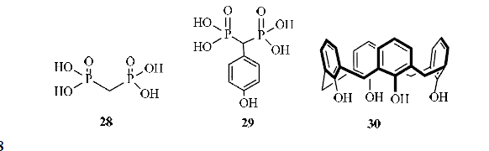
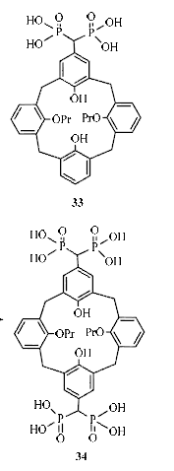
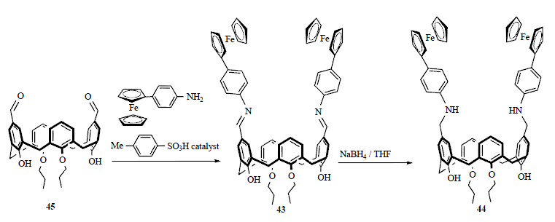
Functionalization
28 and 29:phosphatase inhibitory properties
Introduction of methylenebisphosphonic acid 28 onto 30 form compounds such as 33 and 34, results in the efficient inhibition of alkaline phosphatase
Whereas this inhibition of 28 itself is only very low
Dialdehyde 45 with 4-ferrocenylaniline, affording the Schiff base 43 and reduction to 44
43 and 44 electrochemically recognize La³⁺, Ce³⁺, Pb²⁺ and Cu²⁺ ions

Slide 20
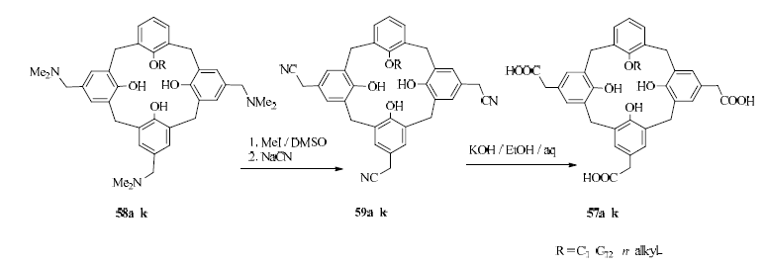
Functionalization
58a-k with MeI to form quaternary ammonium salts
Reaction with sodium cyanide yield tris(cyanomethyl)calixarenes 59a-k.
Hydrolysis of 59a-k with KOH hydroxide affords triscarboxycalixarenes 57a-k
All were found to form typical micelles in aqueous media at biologically relevant pH 6 and pH 8 values.

Slide 21
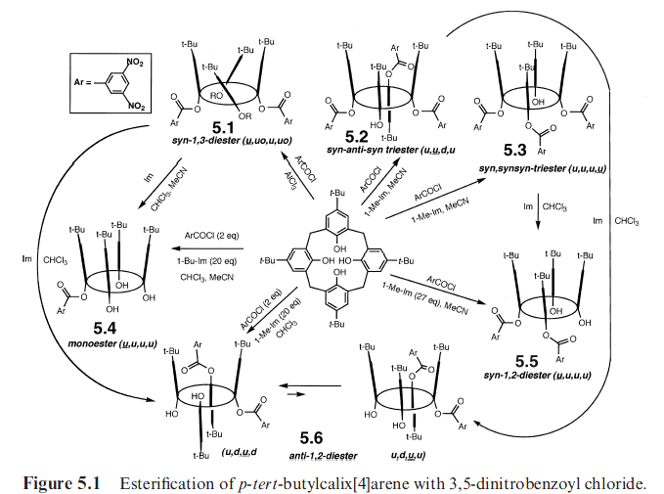
Functionalization
B. Lower-rim modification of calix[n]arenes
Less subjected to modifications, applications far greater
Esterification
Acid halides with presence of bases weaker than NaH
Limiting amounts of the esterifying reagent and/or bulky
esterifying reagents -> obtain partially substituted calixarenes
equivalents of reactants
the base (imidazole, 1methylimidazole and 1butylimidazole)
the solvent (CHCl3. MeCN)

Slide 22
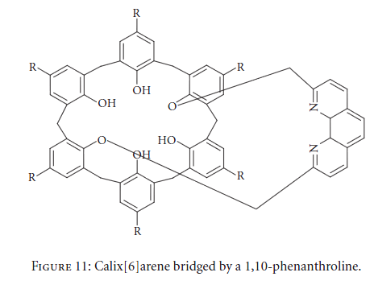
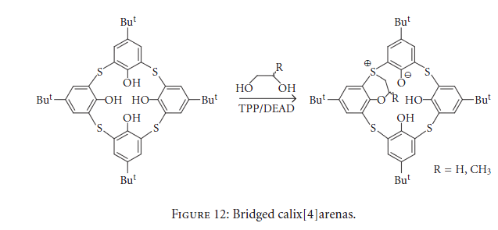
Functionalization
ii. Etherification
With excess of the alkylating
agent, 1,3-diethers were produced, often in very high yields
1,10-phenanthroline was used as a spacer to link intramolecularly
It can complex with Cu
Alkylation of the sulfide bridge was achieved by the cyclocalkylation of p-tert-butylcalix[4]arene
and p-tert-butylthiacalix[4]arene with various aliphatic glycols.
This intrabridging of the calix[4]arene afforded 1,2- and 1,3-bridged calixarenes with O, S-cyclization, which caused the formation of sulfonium phenoxide

Slide 23
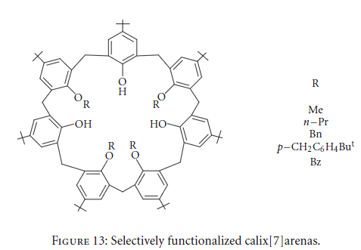
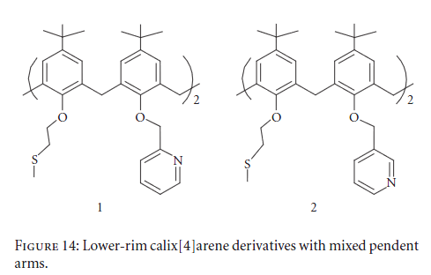
Functionalization
The first example of selectively functionalized calix[7]arenes has been obtained by weak-base
Mono, 1,3- and 1,4-disubstituted
calix[7]arenes : workable yields
1,2,4,6-tetra substitution surprisingly high selectivity by 50–88% yield (KOH as base)
Alkylation with aryl methyl halides containing hetero atoms
Methylthioethoxy and pyridyl 2methyl oxy groups were introduced at the lower rim of calix[4]arene to give rise to bis derivatives of both types 1 , 2

Slide 24
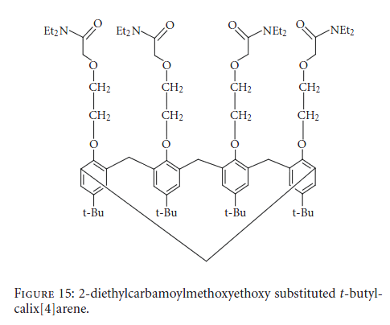
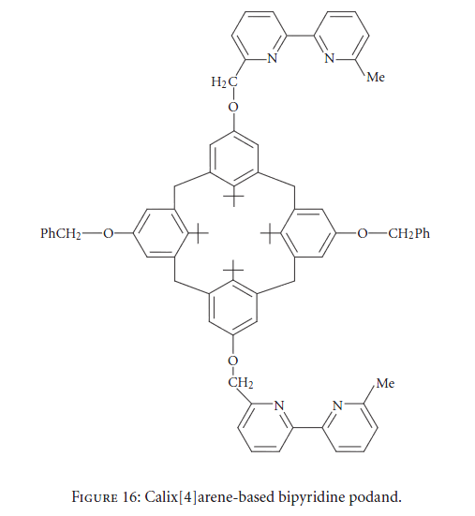
Functionalization
Selective 2,2-bpyridine units at 1,3 position and two benzyl units at 2,5 positions
An ether-amide linkage was synthesized using 2-diethylcarbamoylmethoxyethoxy group at the lower rim of t-butyl-calix[4]arene

Slide 25
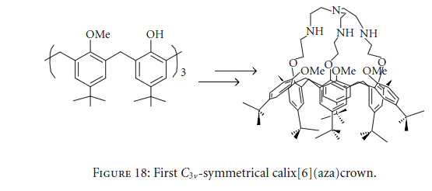
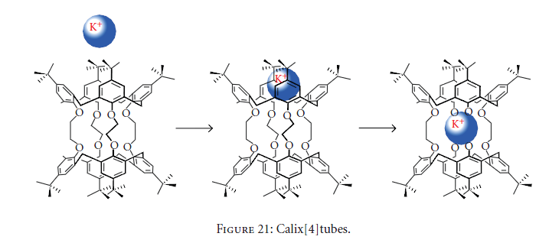
Functionalization
five-step synthesis procedure to give a cone conformation
Bis-calixarenes connected by four tetraalkyltetra(tosyl-oxy-ethoxy) groups have been reported called as calixtubes, in high yields in 71% yield.
Highly selective for complexation of K

Slide 26
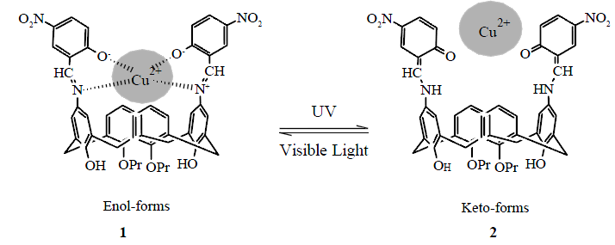
Applications
Calixarenes as potential ligand for metal ions sensing
Calix[4]arene based derivatives equipped with sensing functional groups selectively recognize and form complexes with metal ions
Liang (2007) demonstrated that 5-nitro-salicylaldehyde groups at the upper rim of calix[4]arene (1&2) can effectively recognize Cu(II) ions

Slide 27
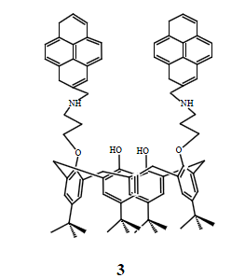
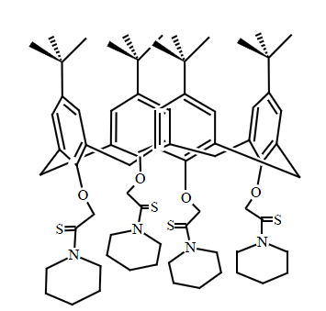
Applications
Sahin and Yilmaz : pyrene armed calix[4]arene derivative for Pb(II), Zn(II), Cu(II) and Mg(II) (3)
Kulesza (2011) : p-tert-butyl-calix[4]arene-thioamide based ligand for extraction and sensing of Pb(II) from aqueous media

Slide 28
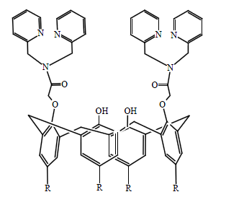
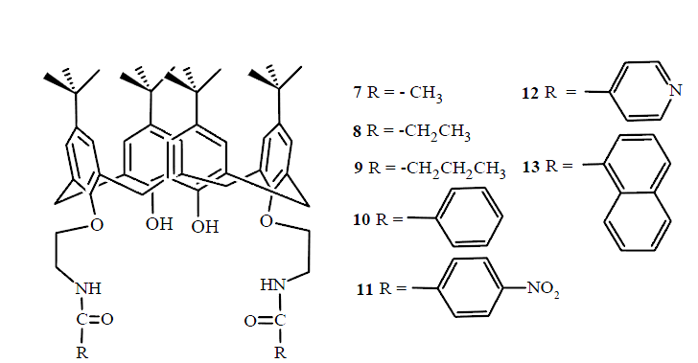
Applications
Joseph (2009) : can sense Cu(II) ions selectively up to the concentration of 196-341 μgL-1 from aqueous methanol
Chen(2006) : double armed calix[4]arene based ligands (7-13), all are found to be selective for Pb(II) over a wide range of concentration 1x10-6-1x10-1 M
Higher stability of more than two months.

Slide 29
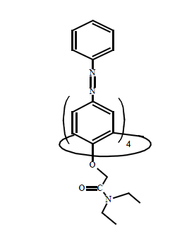
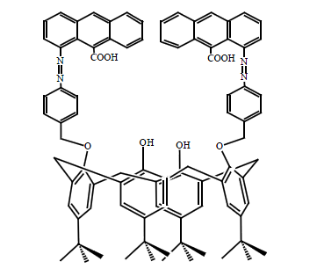
Applications
Binds heavy metal pollutants like Ni(II), Co(II), Cd(II), Cu(II)
Qazi (2010) : ligand for the selective complexation of Cd(II) and Cu(II)
Anchored two signaling units of anthracenyl on the lower rim of p-tert-butylcalix[4]arene
Complexation ability of the chemosensor was tested against selected transition metals like Cd(II),Ni(II), Co(II), Cu(II) and Pb(II)
Among these ions better response was found for Cd(II) and Cu(II)
Complexation behavior studied through FT-IR.

Slide 30
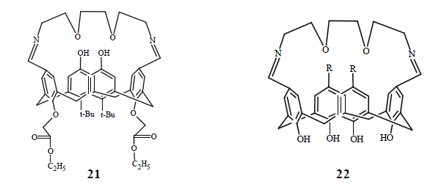
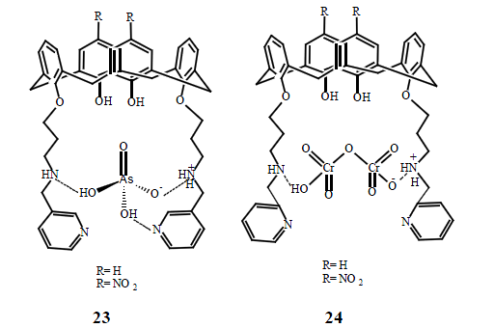
Applications
Calixarenes as toxic metal ions extractants
Yilmaz (2002): two newly synthesized calix[4]arene based azacrown ionophores (21&22) for the removal of chromate ions from water
Bayrakcı (2009): (23) and (24) ionophores which have excellent structural units and interacts with the target arsenate and chromate ions through hydrogen bonding

Slide 31


Applications
Sayin (2010) : novel grafted N methylglucamine derivative of calix[4]arene for the extraction of dichromate/arsenate from water
Memon (2001): Schiff base type calixarene
receptor.
In protonated alkylinium form act as an
efficient trap for transferring alkali and chromate anions

Slide 32

Applications
Calixarenes as catalysts
Cyclodextrins, cyclophanes, curcurbiturils, calixarenes : platforms for synthesizing enzyme mimics thanks to their ability to form inclusion complexes
Attention to: synthetic metallonucleases for the cleavage of phosphodiester DNA bonds
Cleavage of phosphodiester bonds in diribonucleoside monophosphates (NpN’)
Rate accelerations: order of 104 fold for proximal 1,2-dimetallic (11-Cu2) and trimetallic (13-Cu3) complexes
Comparison with 14-Cu and 10-Cu revealed that 11-Cu2 and 13-Cu3 act cooperatively
1,3-distal 12-Cu2 : no metal ion cooperativity
Position (proximal vs. distal) Me on the calixarene scaffold important
12-Cu2 (1,3-distal) : low catalytic activity

Slide 33


Applications
Calixarenes as chiral recognition devices
Pharmaceutical industry: undesirable enantiomers in drug raw material
Devices with excellent chiral discrimination
Calixarene derivative containing propranolol moities on the lower rim : discriminate the enantiomers of phenylalaninol
Enhancement in the enantiomeric discrimination by binding of the calixarene K+

Slide 34

Applications
Esthetics
Building esthetic molecules with calixarenes → molecular Football World Cup

Slide 35
Conclusions
A class of cyclooligomers formed via a phenol-formaldehyde condensation in presence of strong acid or base
An immense interest of researchers in these macrocyclic compounds is because of their easy synthesis, greater yield, and functionalization of their aromatic core (narrow or wide rim) with different functional groups
Calix[n]arenes (n = 4–8), like cyclodextrins and crown ethers, have played an important role as host for ions, neutral molecules, and organic guests
Unlimited possibilities range from selective sensors for different analytical applications and medical diagnostics to their use in decontamination of wastewater, construction of electrodes, and tackling problems of biological interest

Slide 36
ΒΙΒΛΙΟΓΡΑΦΙΑ
https://www.google.gr/search?q=calixarene&biw=1600&bih=775&source=lnms&tbm=isch&sa=X&ei=NKcvVfjoIoPUau7qgOAL&ved=0CAcQ_AUoAQ
https://www.google.gr/search?q=formaldehyde+structure&biw=1600&bih=775&source=lnms&tbm=isch&sa=X&ei=l6YvVefQNYGVaszMgegD&ved=0CAcQ_AUoAQ
Literature Review, σελ. 19- 35
http://en.wikipedia.org/wiki/Calixarene
Applications of Calixarenes in Polymer Synthesis, Weipu Zhu, Pengfei Gou, Zhiquan Shen, Makromol. Symp. 2008, 261, 74-84, Wiley –VCH
http://en.wikipedia.org/wiki/Resorcinol
http://en.wikipedia.org/wiki/Pyrogallol
http://en.wikipedia.org/wiki/Phenol
Calixarenes An Introduction 2nd Edition, C. David Gutsche, The Royal Society of Chemistry
https://www.google.gr/search?q=p-tert-butyl+calix+arene&biw=1600&bih=775&source=lnms&tbm=isch&sa=X&ei=uaYvVZzNFMj1atu_gfAO&ved=0CAcQ_AUoAQ
http://www.chemeurope.com/en/encyclopedia/Calixarene.html
Lower Rim RimSubstituted Calixarenes and Their Applications, Review Article, Princy Jose and ShobanaMenon , Hindawi Publishing Corporation Bioinorganic Chemistry and Applications
https://www.google.gr/search?q=cyclodextrin&biw=1600&bih=731&tbm=isch&tbo=u&source=univ&sa=X&ei=u6UvVcaGO4LfauahgOgP&ved=0CCwQsAQ&dpr=1
https://www.google.gr/search?q=crown+ether&biw=1600&bih=775&source=lnms&tbm=isch&sa=X&ei=aqYvVfzdOsbZarz1gfAB&ved=0CAcQ_AUoAQ
Calixarenes: from biomimetic receptors to multivalent ligands for biomolecular recognition Francesco Sansone,Laura Baldini, Alessandro Casnati and Rocco Ungaro, New J. Chem., 2010, 34, 2715–2728, 2010
https://www.google.gr/search?q=phenylalaninol&biw=1600&bih=731&source=lnms&tbm=isch&sa=X&ei=xzAxVfLOA8LVasuZgJAP&ved=0CAcQ_AUoAg&dpr=1
Important calixarene derivatives – their synthesis and applications, Gillian McMahon, Shane O’Malley, Kieran Nolan, and Dermot Diamond, ARKIVOC 2003 (vii) 23-31
Functionalization reactions of calixarenes , Wanda Sliwa and Malgorzata Deska , Reviews and Accounts ARKIVOC 2011 (i) 496-551

Slide 37


